Slide 1
Applied Statistics for AI (CMAI 6203 ) Week-2 Lecture-3
Topic : Data handling

Slide 2
In this lecture students will learn
How to handle data
How to clean data
How to pre process data

Slide 3
Data handling
In the context of AI and statistics, data cleaning and data preprocessing are the essential steps of turning messy, real-world "raw" data into a polished, high-quality format that machine learning models can understand.
Data scientists and AI engineers often spend 45% to 60% of their time on these stages because the performance of any AI model depends entirely on the quality of its input.

Slide 4
Data Cleaning: The "Fixing" Stage
Data cleaning is a subset of preprocessing. It focuses specifically on finding and correcting errors, inconsistencies, and inaccuracies within a dataset.
Handling Missing Values: Gaps in data are filled using statistical measures (mean, median, mode) or by removing incomplete rows.
Removing Duplicates: Redundant entries are identified and deleted to prevent skewed results.
Managing Outliers: Extreme values that deviate significantly from the rest are identified (using tools like box plots or z-scores) and then either removed, capped, or transformed.

Slide 5
Fixing Structural Errors: Correcting typos, standardizing inconsistent labels (e.g., changing "M" and "Male" to one format), and ensuring dates follow a single convention.

Slide 6
Data Preprocessing: The "Preparing" Stage
Data preprocessing is an umbrella term that includes data cleaning but also covers broader transformations to make the data "model-ready".
Feature Scaling: Adjusting numerical data so all features contribute equally. Common methods include Normalization (scaling values to a 0–1 range) and Standardization (adjusting data to have a mean of 0 and a standard deviation of 1).

Slide 7
Data Preprocessing: The "Preparing" Stage
Encoding Categorical Variables: Converting non-numeric labels (like "Red" or "Blue") into numbers that algorithms can process, often using techniques like One-Hot Encoding.
Data Reduction: Simplifying the dataset by removing irrelevant features or using techniques like PCA (Principal Component Analysis) to reduce dimensionality without losing key information.
Data Integration: Merging data from multiple sources (like different databases or APIs) into one coherent dataset.

Slide 8
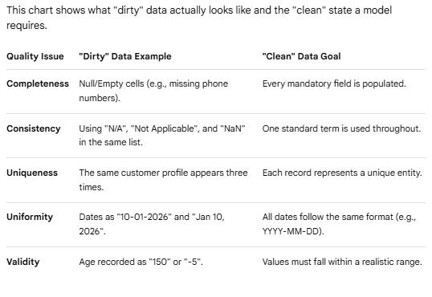
Comparison Chart: Dirty vs. Clean Data

